Slide 1


Multimodal Emotional Recognition System
Paras Khanal, Vincent Sanchez, Shokhina Jalilova
New Mexico State University
Department of Computer Science

Slide 2
Introduction
human communication increasingly occurs through online platforms such as social media, messaging applications, discussion forums, video conferencing systems, and digital review platforms.
These interactions often contain rich emotional information expressed through written language, facial expressions, and other behavioral cues.
At the same time, Artificial Intelligence (AI) has become deeply integrated into daily life

Slide 3
Applications
Human-computer interaction
Online education
Customer satisfaction
Healthcare
Mental health improvement
Behavior health
Telemedicine
Virtual care

Slide 4
Motivation
Although modern AI systems can communicate with humans, they still struggle to truly understand human emotions.
In facial image, lighting, face angles, similar facial expressions, cultural variation make it challenging
Emotions are subtle and context-dependent
Single-modality systems (text-only or image-only) often miss important emotional cues.
These limitations reduce the ability of AI systems to recognize subtle emotional indicators associated with increasing mental health issues.

Slide 5
Motivation
AI systems can communicate with humans, but they still struggle to understand human emotions.
Emotional intelligence is essential for creating more natural, empathetic, and human-centered AI systems.
Multimodal emotion recognition can improve applications in various fields, such as Mental health support, online education, human-computer interaction
Healthcare
Education
Customer service
Human-computer interaction
This work aims to advance affective computing for real-world emotionally aware AI applications.

Slide 6

Related work
Dr. Rosalind Picard pioneered through the field Affective (Emotional) Computing​ - published book in 1977
She states the emotional intelligence as a core component for intelligent machines.
Her applications include:
Autism and Affectiva: manage seizure risk and facilitate better understanding of emotions.
Precision Medicine for depression
Her mission is to mitigate epidemic of depression and suicide – current rate: taking more lives and costing more long-term disability than cancer.

Slide 7
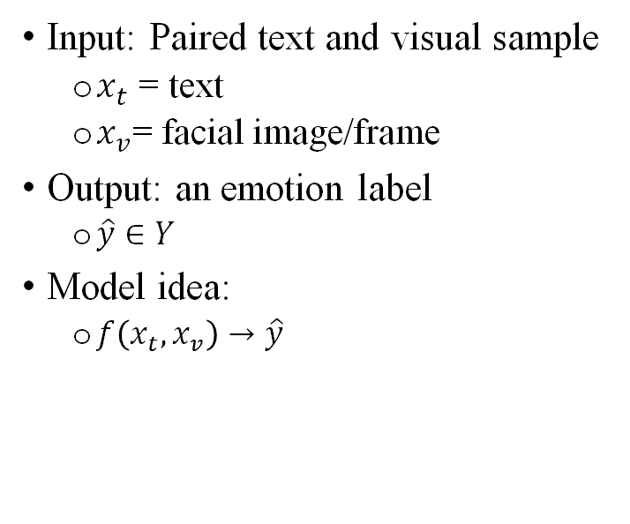
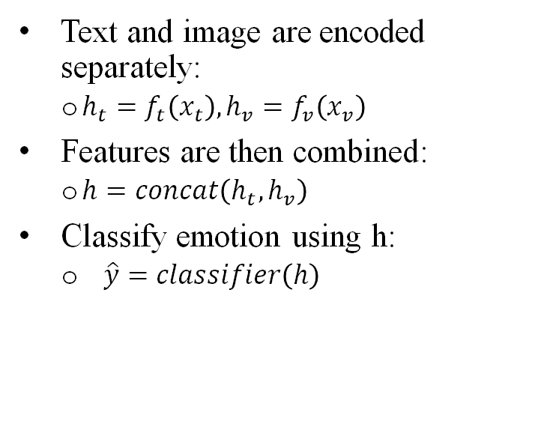
Problem Statement
We define emotion recognition as a supervised multi-class classification problem
Input: Paired text and visual sample
$x_{t}$ = text
$x_{v}$= facial image/frame
Output: an emotion label
$\hat{y}∈Y$
Model idea:
$f\left(x_{t},x_{v}\right)→\hat{y}$
Text and image are encoded separately:
$h_{t}=f_{t}\left(x_{t}\right),h_{v}=f_{v}\left(x_{v}\right)$
Features are then combined:
$h=concat\left(h_{t},h_{v}\right)$
Classify emotion using h:
$\hat{y}=classifier\left(h\right)$
Key idea: Combine language and facial cues to predict emotion more accurately than using one modality alone
Notes:
Y is the set of emotion classes
H is the learned feature representation of the input
F is the model function that maps the input to and emotion prediction
Classifier is fully connected head made of linear layers, GELU activations, and dropout

Slide 8
Datasets
Twitter Emotions:
416,809 tweets, 6 classes (sadness, joy, love, anger, fear, surprise). Moderate imbalance: joy+sadness ~60% of samples. Used 80/20 stratified split.
OAHEGA (Facial):
~15,500 RGB images, 6 classes. Significant imbalance: Happy/Neutral/Sad ~2,700 each vs. Angry/Surprise/Ahegao ~900. Used 70/15/15 split.
MELD (Multimodal):
13,708 utterances from Friends TV, 7 classes, synchronized text + video. Severe imbalance: neutral 46.8%, disgust+fear only 3.5%. Pre-split train/dev/test.
Key challenge:
MELD neutral:disgust ratio up to 25:1 — accuracy alone is misleading. Cohen's Kappa required for honest evaluation.

Slide 9
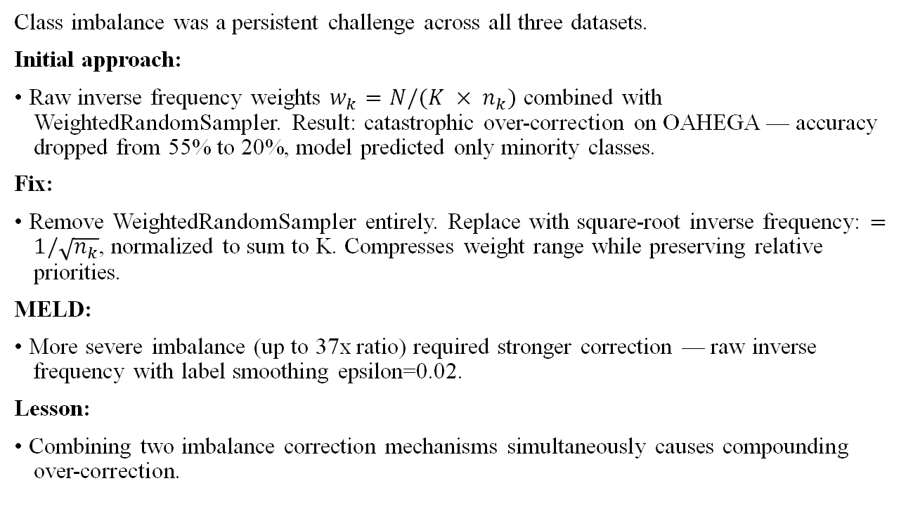
Challenges
Class imbalance was a persistent challenge across all three datasets.
Initial approach:
• Raw inverse frequency weights $w_{k}=N/(K × n_{k})$ combined with WeightedRandomSampler. Result: catastrophic over-correction on OAHEGA — accuracy dropped from 55% to 20%, model predicted only minority classes.
Fix:
• Remove WeightedRandomSampler entirely. Replace with square-root inverse frequency: $=1/\sqrt{n_{k}}$, normalized to sum to K. Compresses weight range while preserving relative priorities.
MELD:
• More severe imbalance (up to 37x ratio) required stronger correction — raw inverse frequency with label smoothing epsilon=0.02.
Lesson:
• Combining two imbalance correction mechanisms simultaneously causes compounding over-correction.

Slide 10
Methodology (Models 1-5)
Models 1-2 — Classical text baselines: We followed the standard TF-IDF + classifier design. Key finding: LR (89.7%) outperforms RF (85.6%) -- sparse high-dimensional representations favor linear boundaries.
Model 3 — DistilBERT: We followed the standard DistilBERT fine-tuning design. Key implementation detail: the pretrained CLS token embeddings is reused directly as the text encoder in both multimodal fusion models (models 7-8). AdamW lr=2e-5, 10 epochs, 91.8% accuracy.
Model 4 — CNN from scratch: We followed the standard CNN design of 3 conv blocks, 32->64->128 filters, 48x48 input). Key finding: 55.4% accuracy. Angry class had 0% recall – not an imbalance issue. For example: Ahegao had way fewer samples yet achieves 82% F1. The root cause is feature capacity.
Model 5 — ResNet-18 transfer: We followed the ResNet design from class but implemented it differently: two-phase fine-tuning with differential learning rates.
Phase 1: freeze backbone, train head only (10 epochs, lr=1e-3)
Phase 2: unfreeze layer4, differential LRs – backbone lr=1e-4, head lr=1e-3 (20 epochs)
Result: 79.6% accuracy (+24.2 pts over CNN), Angry: 0% -> 68% F1

Slide 11
Methodology (Models 6-8)
Models 6 — Multimodal Fusion with Unaligned Data: We paired the Twitter text dataset with the OAHEGA images by matching emotion labels. Key finding: served as an important baseline but failed because the text and image did not have the same context. Had an accuracy of 38.5% which was close to random classification.
Model 7 — Multimodal Fusion with CNN Encoder: We switched to the aligned MELD dataset using DistilBERT for text, our CNN from scratch for images, and cross-modal attention for fusion. Key finding: alignment improved performance compared to the unaligned baseline, but the CNN image encoder remained a bottleneck. Achieved 42.2% accuracy, a 3.7% accuracy boost.
Model 8 — Final System Architecture: We kept the aligned MELD dataset, DistilBERT text encoder, and cross-modal attention fusion, but replaced the CNN with the pretrained ResNet-18 for images. Since the encoders output different vector sizes, a linear layer is applied to produce matching 256-dimensional features. Cross-modal attention lets each modality interact before fusion. The final 512-dimensional vector is then classified into 7 emotion classes. Achieved accuracy of 47.6%, a 5.4 percentage point improvement over model 7.
Notes:
Model 3 outputs 768-dimensional vector and model 5 outputs 512-dimensional image feature vector. Both passed through linear layer to match dimensions.

Slide 12
Results and Findings
Model | Accuracy | Macro F1 | Kappa | ROC-AUC
Random Forest (TF-IDF) | 85.6% | — | — | —
Logistic Regression (TF-IDF) | 89.7% | — | — | —
DistilBERT (fine-tuned) | 91.8% | — | — | —
CNN from scratch | 55.4% | 0.41 | — | —
ResNet-18 (transfer learning) | 79.6% | 0.80 | — | —
Multimodal — unaligned (failed) | 38.5% | 0.14 | 0.00 | 0.50
Multimodal — MELD + CNN | 42.2% | 0.31 | 0.29 | 0.74
Multimodal — MELD + ResNet-18 | 47.6% | 0.31 | 0.31 | 0.74

Slide 13
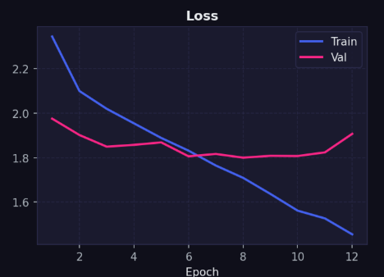
Loss Curve
Converge through epoch 6
Early stopping selected epoch 8 checkpoint

Slide 14
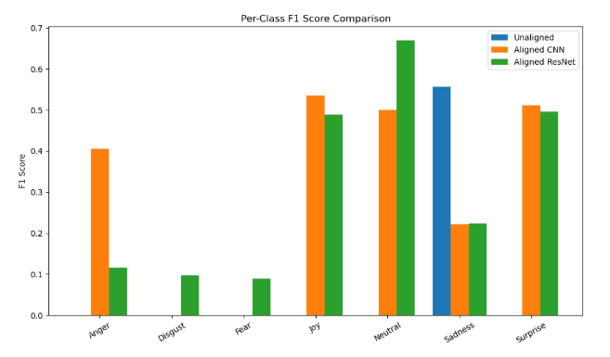
Performance of unaligned vs aligned data

Slide 15
Conclusion
The multimodal model trained on unaligned data failed to learn meaningful emotional expressions.
Models trained with aligned MELD dataset demonstrated clear improvements in both accuracy and class-level performance.
However, Multimodal models did not surpass the performance of the best unimodal text model.
More advanced fusion strategies may be required.

Slide 16
Limitations
The multimodal models relied on a single frame representation of video data, which may not fully capture dynamics of facial expressions.
lass imbalance in the datasets posed a significant challenge.
Despite weighting strategies, minority classes such as disgust and fear remained difficult to classify accurately.

Slide 17
Next steps
explore more sophisticated multimodal fusion techniques
Incorporate additional modality – audio

Slide 18

Thank You!

